Slide 1
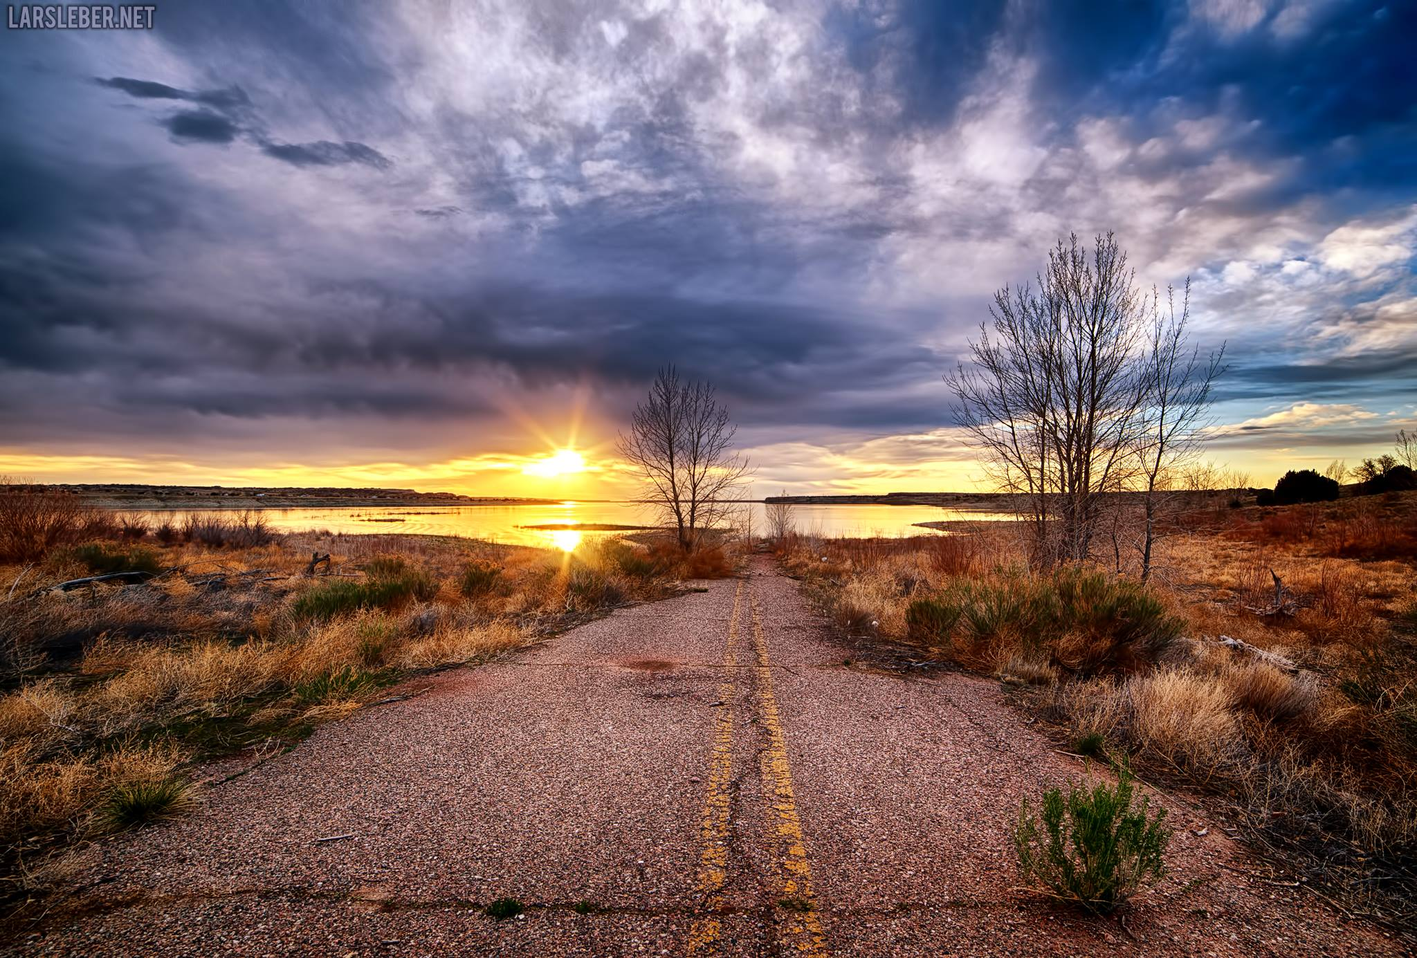
THE LIFE OF CHRIST
PART 72

Slide 2
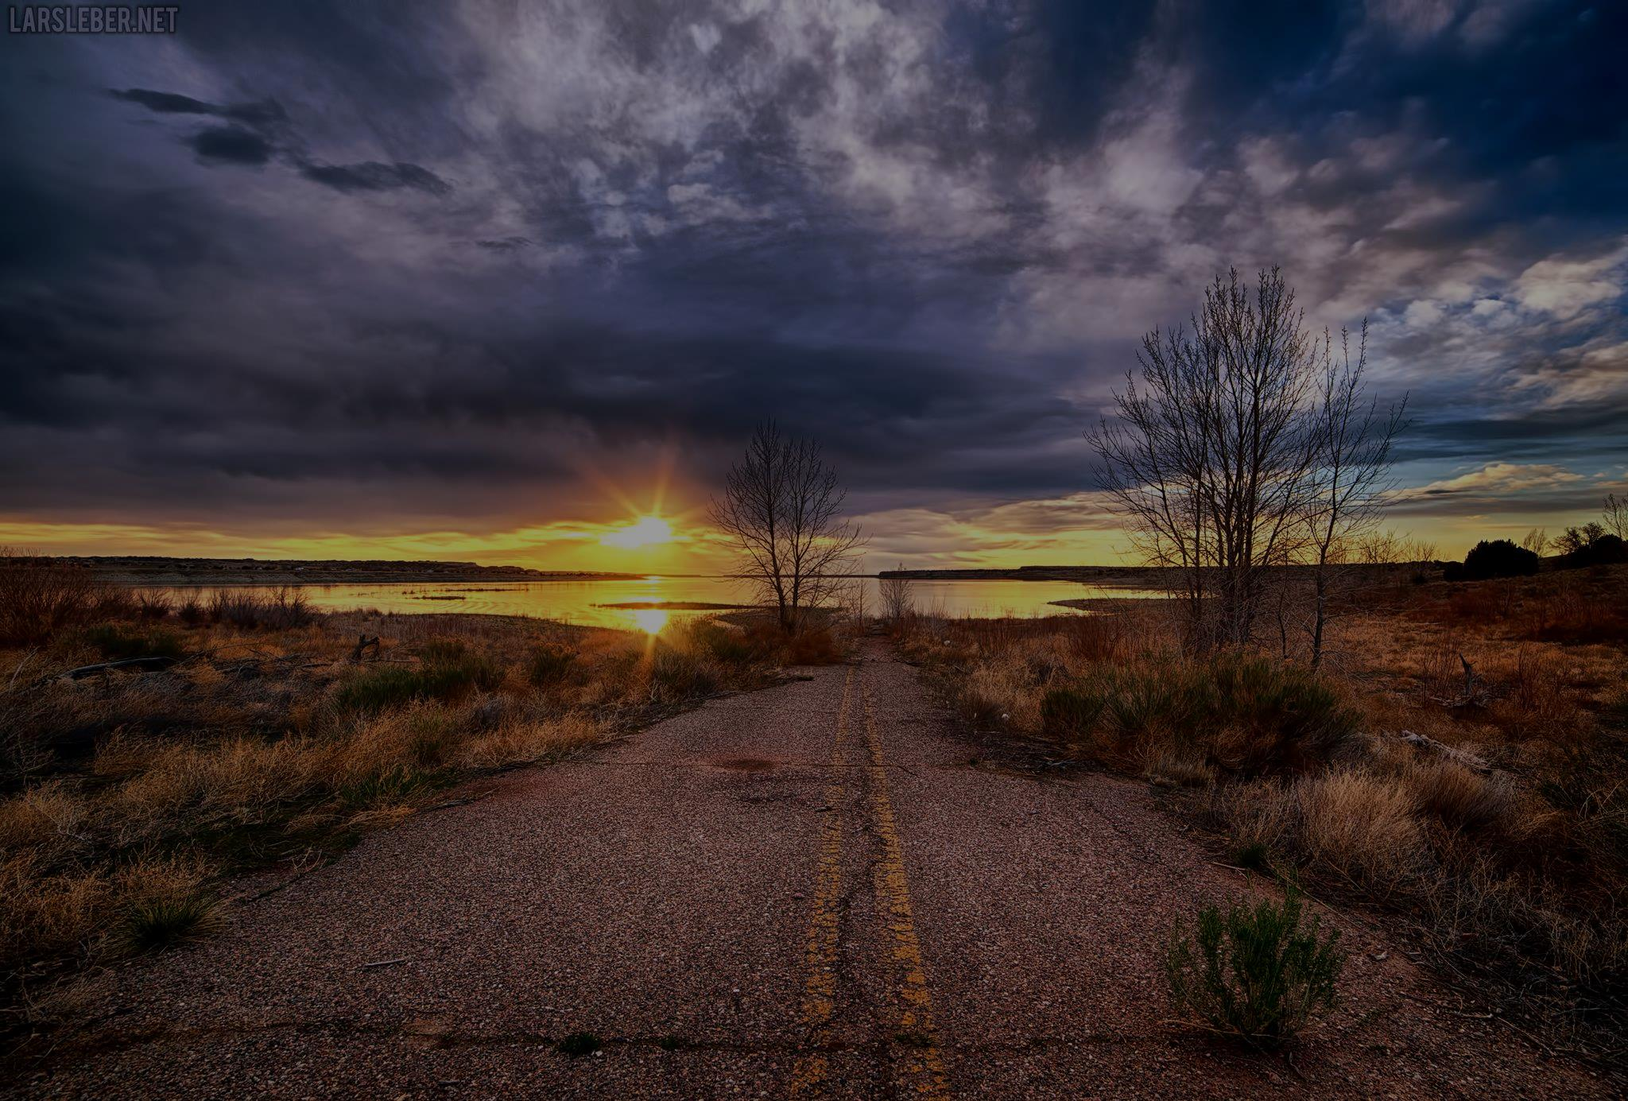
Mark 10:32 Now they were on the road, going up to Jerusalem, and Jesus was going before them; and they were amazed. And as they followed they were afraid. Then He took the twelve aside again and began to tell them the things that would happen to Him: ³³ "Behold, we are going up to Jerusalem, and the Son of Man will be betrayed to the chief priests and to the scribes; and they will condemn Him to death and deliver Him to the Gentiles; ³⁴ "and they will mock Him, and scourge Him, and spit on Him, and kill Him. And the third day He will rise again."

Slide 3
Luke 18:31 Then He took the twelve aside and said to them, "Behold, we are going up to Jerusalem, and all things that are written by the prophets concerning the Son of Man will be accomplished. ³² "For He will be delivered to the Gentiles and will be mocked and insulted and spit upon. ³³ "They will scourge Him and kill Him. And the third day He will rise again." ³⁴ But they understood none of these things; this saying was hidden from them, and they did not know the things which were spoken.

Slide 4
He points out that everything that is going to happen to Him was predicted by the prophets and that He we accomplish what they predicted.
He will be betrayed, which was done by Judas, and He will be handed over to the chief priest and scribes. Since they cannot kill Jesus by Roman law, they will hand him over to Pilate who is a Gentile.
They will mock Him, scourge Him, spit on Him and kill Him.
In 3 days, He will rise again.

Slide 5
Mark 10:35 Then James and John, the sons of Zebedee, came to Him, saying, "Teacher, we want You to do for us whatever we ask." ³⁶ And He said to them, "What do you want Me to do for you?"
Matthew 20:20 Then the mother of Zebedee's sons came to Him with her sons, kneeling down and asking something from Him. ²¹ And He said to her, "What do you wish?" She said to Him, "Grant that these two sons of mine may sit, one on Your right hand and the other on the left, in Your kingdom."

Slide 6
Matthew 20:22 But Jesus answered and said, "You do not know what you ask. Are you able to drink the cup that I am about to drink, and be baptized with the baptism that I am baptized with?" They said to Him, "We are able." ²³ So He said to them, "You will indeed drink My cup, and be baptized with the baptism that I am baptized with; but to sit on My right hand and on My left is not Mine to give, but it is for those for whom it is prepared by My Father."

Slide 7
Matthew 26:39 "O My Father, if it is possible, let this cup pass from Me; nevertheless, not as I will, but as You will."

Slide 8
Matthew 20:24 And when the ten heard it, they were greatly displeased with the two brothers.

Slide 9
Matthew 20:25 But Jesus called them to Himself and said, "You know that the rulers of the Gentiles lord it over them, and those who are great exercise authority over them. ²⁶ "Yet it shall not be so among you; but whoever desires to become great among you, let him be your servant. ²⁷ "And whoever desires to be first among you, let him be your slave -- ²⁸ "just as the Son of Man did not come to be served, but to serve, and to give His life a ransom for many."

Slide 10
Luke 17:10 "So likewise you, when you have done all those things which you are commanded, say, 'We are unprofitable servants. We have done what was our duty to do.' "

Slide 11
Matthew 20:29 Now as they went out of Jericho, a great multitude followed Him. ³⁰ And behold, two blind men sitting by the road, when they heard that Jesus was passing by, cried out, saying, "Have mercy on us, O Lord, Son of David!" ³¹ Then the multitude warned them that they should be quiet; but they cried out all the more, saying, "Have mercy on us, O Lord, Son of David!"
Mark 10:46 Now they came to Jericho. As He went out of Jericho with His disciples and a great multitude, blind Bartimaeus, the son of Timaeus, sat by the road begging. ⁴⁷ And when he heard that it was Jesus of Nazareth, he began to cry out and say, "Jesus, Son of David, have mercy on me!" ⁴⁸ Then many warned him to be quiet; but he cried out all the more, "Son of David, have mercy on me!"

Slide 12
Luke 18:35 Then it happened, as He was coming near Jericho, that a certain blind man sat by the road begging. ³⁶ And hearing a multitude passing by, he asked what it meant. ³⁷ So they told him that Jesus of Nazareth was passing by. ³⁸ And he cried out, saying, "Jesus, Son of David, have mercy on me!" ³⁹ Then those who went before warned him that he should be quiet; but he cried out all the more, "Son of David, have mercy on me!"

Slide 13
The problem of the time or place of this miracle, whether as Christ was leaving or entering Jericho, disappears in the light of what is certainly known about that locality. A. T. Robertson said:
The discrepancy as to place, "as he went out from Jericho," or "as he drew nigh to Jericho," is best explained by the recent suggestion that the healing occurred after he left old Jericho, and as he was approaching the new Jericho which Herod the Great had built at some distance away.^{[3]}

Slide 14
Thus, as always, alleged contradictions flow out of men's ignorance of all the facts, not out of any real errors by the sacred writers. Add to Robertson's observation the obvious and undeniable fact that, with two Jericho's close together, any blind beggar would naturally choose a site between them! Both and all three gospels are correct. He was entering one Jericho, leaving the other. Far from being any problem, therefore, these separate accounts are overwhelming proof that the gospel writers are independent witnesses and completely trustworthy. (Coffman Commentary on Matthew).

Slide 15
Mark 10:49 So Jesus stood still and commanded him to be called. Then they called the blind man, saying to him, "Be of good cheer. Rise, He is calling you." ⁵⁰ And throwing aside his garment, he rose and came to Jesus. ⁵¹ So Jesus answered and said to him, "What do you want Me to do for you?" The blind man said to Him, "Rabboni, that I may receive my sight." ⁵² Then Jesus said to him, "Go your way; your faith has made you well." And immediately he received his sight and followed Jesus on the road.

Slide 16
Luke 18:43 And immediately he received his sight, and followed Him, glorifying God. And all the people, when they saw it, gave praise to God.

Slide 17
Luke 19:1 Then Jesus entered and passed through Jericho. ² Now behold, there was a man named Zacchaeus who was a chief tax collector, and he was rich. ³ And he sought to see who Jesus was, but could not because of the crowd, for he was of short stature. ⁴ So he ran ahead and climbed up into a sycamore tree to see Him, for He was going to pass that way.

Slide 18
Luke 19:5 And when Jesus came to the place, He looked up and saw him, and said to him, "Zacchaeus, make haste and come down, for today I must stay at your house." ⁶ So he made haste and came down, and received Him joyfully.

Slide 19
Luke 19:7 But when they saw it, they all complained, saying, "He has gone to be a guest with a man who is a sinner." ⁸ Then Zacchaeus stood and said to the Lord, "Look, Lord, I give half of my goods to the poor; and if I have taken anything from anyone by false accusation, I restore fourfold." ⁹ And Jesus said to him, "Today salvation has come to this house, because he also is a son of Abraham; ¹⁰ "for the Son of Man has come to seek and to save that which was lost."

